Slide 1
Build your first app
Android Developer Fundamentals V2
Lesson 1

Slide 2
1.3 Text and scrolling views

Slide 3
Contents
TextView
ScrollView

Slide 4
TextView

Slide 5
TextView for text
TextView is View subclass for single and multi-line text
EditText is TextView subclass with editable text
Controlled with layout attributes
Set text:
Statically from string resource in XML
Dynamically from Java code and any source

Slide 6
Formatting text in string resource
Use <b> and <i> HTML tags for bold and italics
All other HTML tags are ignored
String resources: one unbroken line = one paragraph
\n starts a new a line or paragraph
Escape apostrophes and quotes with backslash (\", \')
Escape any non-ASCII characters with backslash (\)

Slide 7
Creating TextView in XML
<TextView android:id="@+id/textview"
android:layout_width="match_parent"
android:layout_height="wrap_content"
android:text="@string/my_story"/>

Slide 8
Common TextView attributes
android:text—text to display
android:textColor—color of text
android:textAppearance—predefined style or theme
android:textSize—text size in sp
android:textStyle—normal, bold, italic, or bold|italic
android:typeface—normal, sans, serif, or monospace
android:lineSpacingExtra—extra space between lines in sp

Slide 9
Formatting active web links
<string name="article_text">... www.rockument.com ...</string>
<TextView
android:id="@+id/article"
android:layout_width="wrap_content"
android:layout_height="wrap_content"
android:autoLink="web"
android:text="@string/article_text"/>
Don’t use HTML for a web link in free-form text
autoLink values:"web", "email", "phone", "map", "all"

Slide 10
Creating TextView in Java code
TextView myTextview = new TextView(this);
myTextView.setWidth(LayoutParams.MATCH_PARENT);
myTextView.setHeight(LayoutParams.WRAP_CONTENT);
myTextView.setMinLines(3);
myTextView.setText(R.string.my_story);
myTextView.append(userComment);

Slide 11
ScrollView

Slide 12
What about large amounts of text?
News stories, articles, etc…
To scroll a TextView, embed it in a ScrollView
Only one View element (usually TextView) allowed in a ScrollView
To scroll multiple elements, use one ViewGroup (such as LinearLayout) within the ScrollView

Slide 13
ScrollView for scrolling content
ScrollView is a subclass of FrameLayout
Holds all content in memory
Not good for long texts, complex layouts
Do not nest multiple scrolling views
Use HorizontalScrollView for horizontal scrolling
Use a RecyclerView for lists

Slide 14
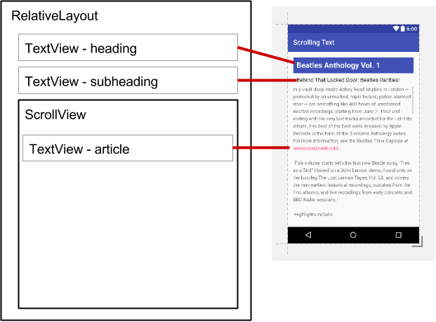
ScrollView layout with one TextView
<ScrollView
android:layout_width="wrap_content"
android:layout_height="wrap_content"
android:layout_below="@id/article_subheading">
<TextView
android:layout_width="wrap_content"
android:layout_height="wrap_content"
.../>
</ScrollView>

Slide 15
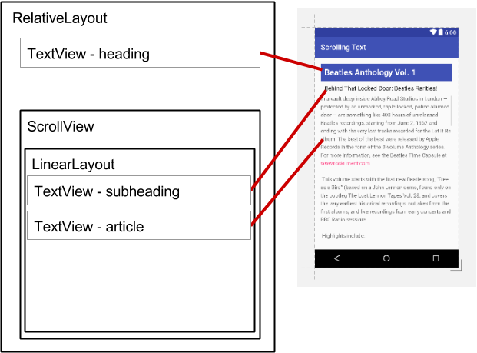
ScrollView layout with a view group
<ScrollView ...
<LinearLayout
android:layout_width="match_parent"
android:layout_height="wrap_content"
android:orientation="vertical">
<TextView
android:id="@+id/article_subheading" .../>
<TextView
android:id="@+id/article" ... />
</LinearLayout>
</ScrollView>

Slide 16
ScrollView with image and button
<ScrollView...> <LinearLayout...> <ImageView.../> <Button.../> <TextView.../> </LinearLayout> </ScrollView>
One child of ScrollView which can be a layout
Children of the layout

Slide 17
Learn more
Developer Documentation:
TextView
ScrollView and HorizontalScrollView
String Resources
Other:
Android Developers Blog: Linkify your Text!
Codepath: Working with a TextView

Slide 18
What's Next?
Concept Chapter: 1.3 Text and scrolling views
Practical: 1.3 Text and scrolling views

Slide 19
END

Slide 20
CODELABS

Slide 21
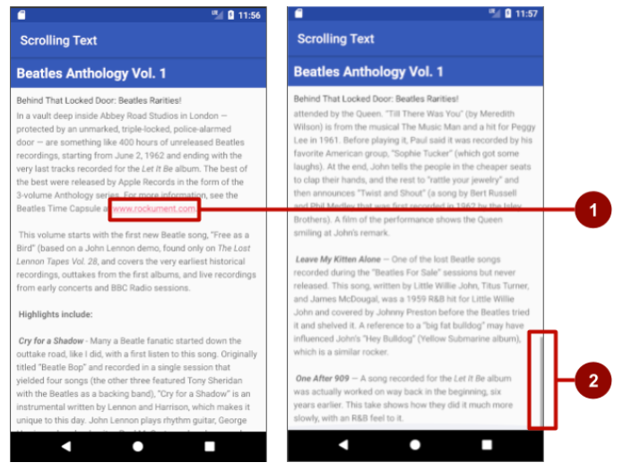
App Overview

Slide 22
Task 1: Add 3 TextView
Title
Subtitle
Article text
Fill the content in and run the app

Slide 23
Task 2: Add a scrollview
Add a Scrollview
Put the ScrollView “below” the subtitle TextView
Move the article TextView into the ScrollView
Run the app

Slide 24
Task 3: Scroll multiple view
Put the ScrollView “below” the title TextView
Create a new “LinearLayout” inside the ScrollView
Move the subtitle and article TextView into the new vertical LinearLayout
Run the app

